Slide 1
An Overview of Anomaly Detection
Henrik Berényi
Budapest, 2025.02.21

Slide 2
Definition of an Anomaly
Also known as outlier, novelty, abnormality
Deviates from other members within a sample
An observation (or subset of observations) which appears to be inconsistent with the remainder of that set of data
Points that do not belong to clusters of a data set or as clusters that are significantly smaller than other clusters
Patterns in data that do not conform to a well defined notion of normal behaviour
An overview of anomaly detection

Slide 3
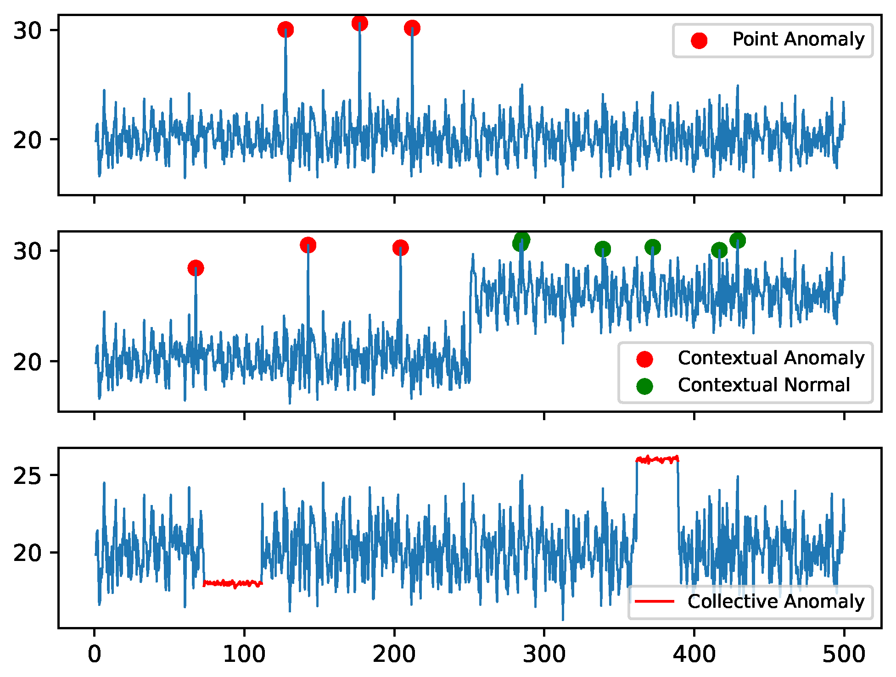
Types of Anomalies
Point/Global – data point that is significally different
Group – collection of data points which are anomalies
Local – an anomaly in terms of its neighbourhood
Collective - collection of similar data points which are anomalies compared to entire dataset
Contextual - the data instance is anomalous in a specific context but not otherwise
An overview of anomaly detection

Slide 4
Applications of Anomaly Detection
Intrusion detection
Fault diagnosis
Healthcare
Fraud detection
Detecting novelty from text
An overview of anomaly detection

Slide 5
Types of Anomaly Detection Algorithms
Algorithms based on statistical models – parametric and non-parametric based on the knowledge of the underlying distribution
They are simpler and more intuitive
Most of the methods can be applied to univariate data only, and it is computationally expensive to use multivariate data
Algorithms based on density – the density of the outlier significantly differs from the normal instance
Performs better than statistics and distance based methods
Computationally expensive due to distance calculation and not suitable for large high-dimensional datasets
An overview of anomaly detection

Slide 6
Types of Anomaly Detection Algorithms
Algorithms based on distance – “anomalies are far away from their nearest neighbors”
Easy to implement
Hight complexity, generally O(n²)
Algorithms based on clustering – outliers/noise is classified as anonalies
Good for unsupervised setting
Highly dependent on the clustering algorithm, both in terms of performance and complexity
Algorithms based on isolation – intuition suggests that anomalies are few and are easy to isolate
Highly scalable
Some methods are only applicable on certain types of data
An overview of anomaly detection

Slide 7
Types of Anomaly Detection Algorithms
Emsemble technique – a combination of different anomaly detection methods
Interpretability conterns due to the usage of deep learning
Difficult tuning
Algorithms based on subspace – searches for anomalies in a subset of features
Good at detecting hidden anomalies
High time complexity
Sensitive to irrelevant attributes
An overview of anomaly detection

Slide 8
Sources
A Comprehensive Survey of Anomaly Detection Algorithms (https://doi.org/10.1007/s40745-021-00362-9)
Unsupervised Anomaly Detection for IoT-Based Multivariate Time Series: Existing Solutions, Performance Analysis and Future Directions (https://doi.org/10.3390/s23052844)
An overview of anomaly detection

Slide 9
Thank you for your attention!

